Slide 1
AI Sessions
Designed for NEOM AI Challenge groups and UPM students

Slide 2
AI Subfields:
Machine learning: it uses different algorithms to find hidden insights in data
A neural network: inspired by human brain. It’s made up of interconnected units/neurons that processes information by responding to external inputs, and pass information between each unit.
Deep learning: huge collection of neural networks with many layers of processing units, requires extremely powerful computing power, to learn complex patterns in large amounts of data.
Many others..

Slide 3
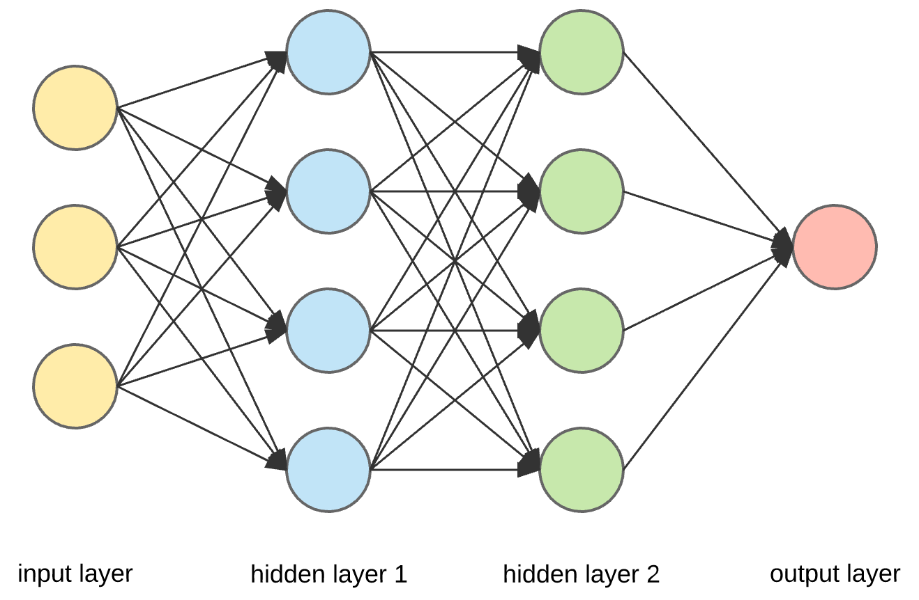

Slide 4
Deep Learning

Slide 5
Deep Learning
Machine Learning

Slide 6
Deep Learning
Why now?
Use it always?

Slide 7

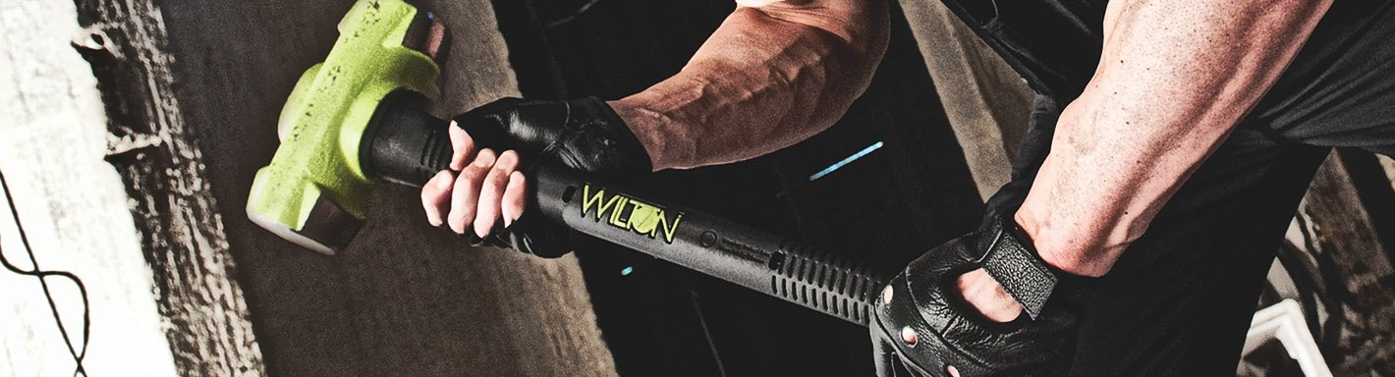

Slide 8
Neural Network

Slide 9
Inputs
Outputs
X1
Y1
X2
Y2
X3

Slide 10
Hidden Layer
Inputs
Outputs
X1
Y1
X2
Y2
X3

Slide 11
Hidden Layer
Inputs
Outputs
X1
Y1
X2
Y2
X3

Slide 12
Hidden Layer
Inputs
Outputs
X1
Y1
X2
Y2
X3
W

Slide 13
Hidden Layer
Inputs
Outputs
X1
Y1
X2
Y2
X3
W
W

Slide 14
Hidden Layer
Inputs
Outputs
X1
Y1
X2
Y2
X3
W
W
W

Slide 15
Hidden Layer
Inputs
Outputs
X1
Y1
X2
Y2
X3
W
W
W

Slide 16
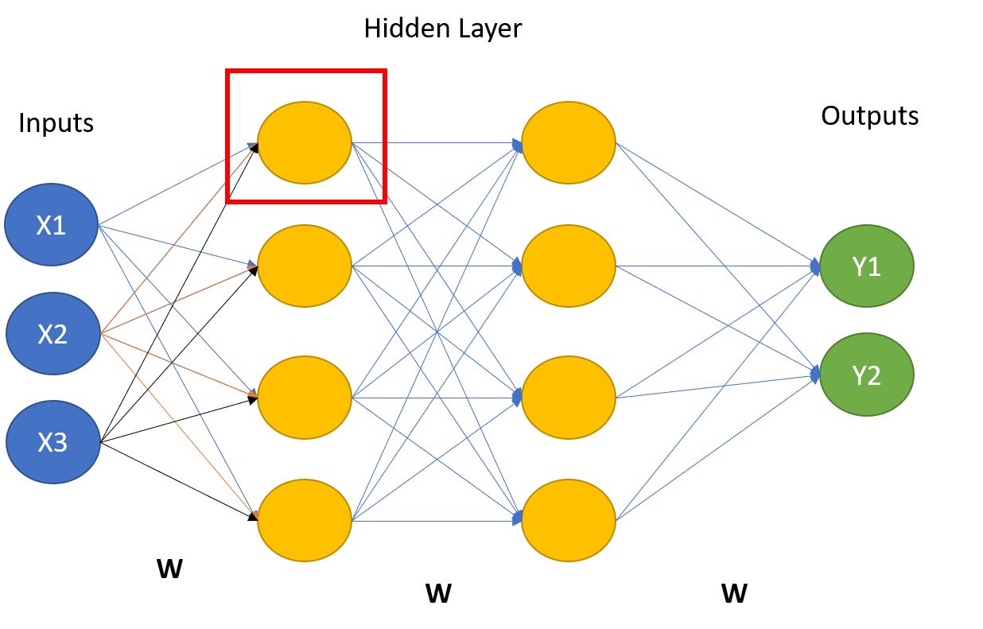
Inputs
X1
X2
X3

Slide 17
Inputs
X1
W
∑
X2
W
X3
W

Slide 18
Inputs
X1
W
∑
Activation Function
X2
W
X3
W

Slide 19
Inputs
Outputs
X1
W
∑
Activation Function
Y1
X2
W
Y2
X3
W

Slide 20

Building a deep learning model

Slide 21
ML vs DL
Steps in Building a ML Model:
Data Collection
Data Pre-Processing
Model Training
Model Evaluation
Parameter Tuning/ optimization
Prediction

Slide 22
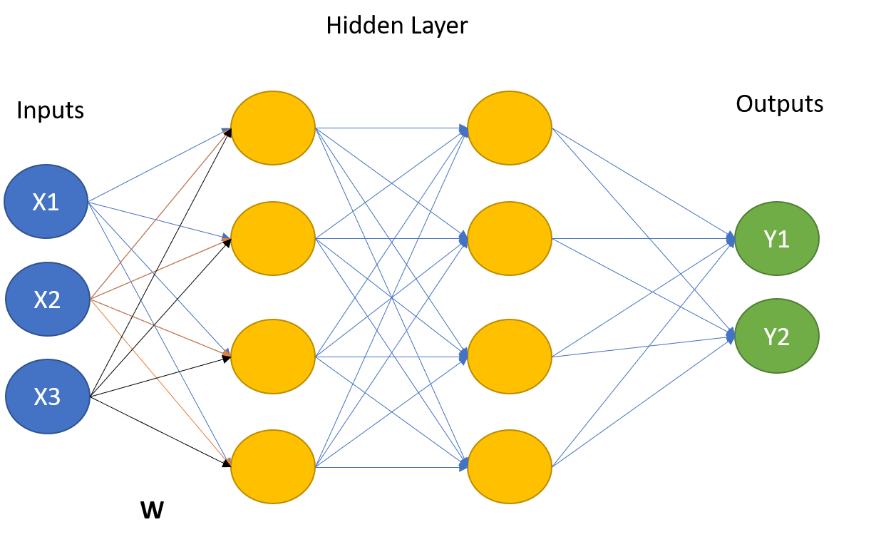
Building a deep learning model
Steps in Building a ML Model:
Data Collection
Data Pre-Processing
Model Training
Model Evaluation
Parameter Tuning/ optimization
Prediction
Steps in Building a DL Model:
Data Collection
Data Pre-Processing
Build the hidden layer
Build the Output layer
Model Training
Model Evaluation
Parameter Tuning/ optimization
Outputs

Slide 23
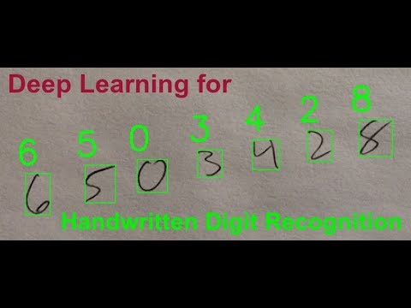
Example: Handwriting Recognition

Slide 24

28X28 = 784 pixels

Slide 25

Use Image Flatten
28X28 pixels
28X28 = 784 Neurons

Slide 26
Hidden Layer
Outputs
0
1
2
3
4
.
.
.
.
.
.
.
.
.
784 Input Neurons
5
6
7
8
9

Slide 27
Deep Learning Practice
Install tenserflow
Import Keras
Use the minst, the “hello world” example of deep learning

